Slide 1

Removing Barriers, Building Communities of Belonging
For through him we both have access to the Father by one Spirit. Ephesians 2:18

Slide 2

Gulf Atlantic Diocese Synod 2022
One Spirit, One Mind, One Mission
Only let your manner of life be worthy of the gospel of Christ, so that … I may hear of you that you are standing firm in one spirit, with one mind striving side by side for the faith of the gospel, ...

Slide 3


Slide 4
Access Leadership Network
Kathy Ayres – Coordinator
Jody Farmer – Training Team
Dr. Elena Rhodes – Training Team
For through him we both have access to the Father by one Spirit. Ephesians 2:18

Slide 5
Removing Barriers, Building Communities of Belonging.
Prepare
Engage
For through him we both have access to the Father by one Spirit. Ephesians 2:18

Slide 6
Gulf Atlantic Diocese Synod 2022 One Spirit, One Mind, One Mission

Slide 7
How can I apply what I learned in my settings?
(my family, my church, my community)
For through him we both have access to the Father by one Spirit. Ephesians 2:18
Notes:
Please take a moment to reflect. You can make notes on the bottom of the Access Leadership Network handout.
(1 minute)

Slide 8
Removing Barriers, Building Communities of Belonging
For through him we both have access to the Father by one Spirit. Ephesians 2:18

Slide 9
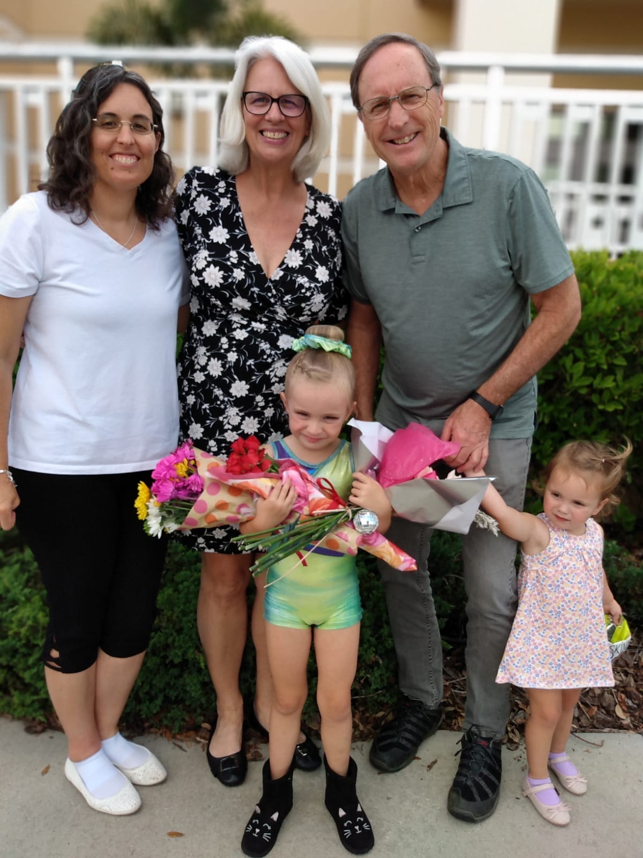
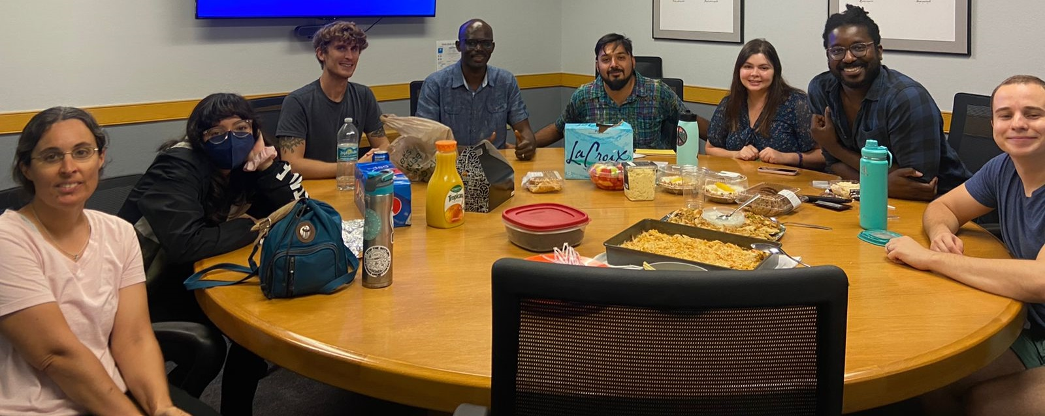
Family
Work

Slide 10
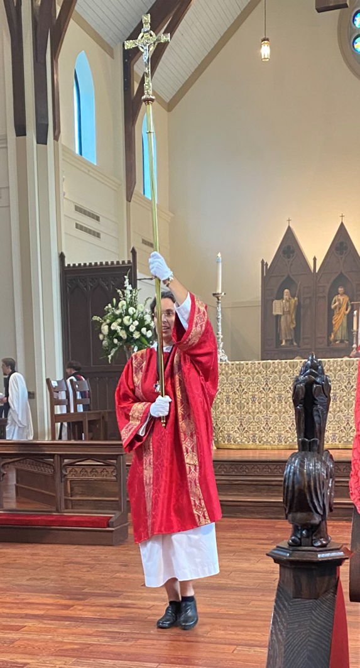
Belonging
Valued and missed when not there
Accepted as I am
Ministering together

Slide 11
Who should join me in considering the 10 Dimensions of Belonging at our church?
For through him we both have access to the Father by one Spirit. Ephesians 2:18
Notes:
Please take a moment to reflect. You can make notes on the bottom of the Access Leadership Network handout.
(1 minute)

Slide 12
Removing Barriers, Building Communities of Belonging
For through him we both have access to the Father by one Spirit. Ephesians 2:18

Slide 13
How do we build
communities of belonging?
We need to be intentional.
Today there are fewer groups which intentionally exclude disabilities
– Exclusion is often the natural outcome of unintentionality.

Slide 14
Removing Barriers, Building Communities of Belonging
Practical strategies
Theological grounding
Notes:
You are likely doing many things in your churches which facilitate connections and belonging.
Taking communion to those unable to attend worship services.
Helping parents struggling with challenging child rearing.

Slide 15
What can my church do?
Practical ways to help in any setting:
Ask
Engage
Partner
For through him we both have access to the Father by one Spirit. Ephesians 2:18
Notes:
Erik Carter’s articles:
A Place of Belonging – rubric for further assessment and planning for your church;
“The Changing Landscape of Disability and Ministry in the Church,”
Currents in Theology and Mission 49:3 (July 2022).

Slide 16
What can my church do?
Practical ways to help in any setting:
Ask – Have online registration for events & activities. Include a line to ask: “Are there any supports or accommodations you need to fully participate?”
Engage – Acknowledge, greet, and give eye contact to people with disabilities. Wrap them into conversations with others.
Partner – If you find yourself in an awkward situation, admit you are unsure what to do. Let the other person know you are glad to be with them. Ask for help in making a way forward.
For through him we both have access to the Father by one Spirit. Ephesians 2:18
Notes:
Erik Carter’s articles:
A Place of Belonging – rubric for further assessment and planning for your church;
“The Changing Landscape of Disability and Ministry in the Church,”
Currents in Theology and Mission 49:3 (July 2022).

Slide 17
Belonging
“As individuals with and without disabilities develop mutual relationships and see one another as indispensable members, communities soon become places of belonging.”
Erik Carter,
The Changing Landscape of Disability and Ministry in the Church,
Currents in Theology and Mission (July 2022).
Notes:
Erik Carter’s articles:
A Place of Belonging – rubric for further assessment and planning for your church;
“The Changing Landscape of Disability and Ministry in the Church,”
Currents in Theology and Mission 49:3 (July 2022).

Slide 18
Inclusion - Ministry with
Inclusion means ensuring individuals with disabilities are encouraged and supported to participate in the same breadth of church experiences as anyone else.
Grounded in core theological beliefs.
More naturally done in smaller congregations- seen as “I’m being a friend with ____.”
Belonging – Ministry with and by
Erik Carter

Slide 19
Theologians with a focus on Disability Theology - University of Aberdeen -
Brian Brock
Disability: Living into the Diversity of Christ’s Body
Wondrously Wounded: theology, disability, and the body of Christ
John Swinton
Walking with Jesus in Strange Places
Finding Jesus in the Storm
Becoming Friends of Time
Notes:
John Swinton – Thick (vs. Thin) Descriptions – rich, deep, and meaningful descriptions, gained by careful listening and not being bound by our presuppositions and assumptions of another person.

Slide 20
As we come to know the
“thick descriptions” of one another,
As we learn, grow, and serve together,
We come closer to becoming the complete body, God calls us toward.
Now you are the body of Christ and individually members of it.
1 Corinthians 12:27

Slide 21
Gulf Atlantic Diocese Synod 2022
One Spirit, One Mind, One Mission
Only let your manner of life be worthy of the gospel of Christ, so that … I may hear of you that you are standing firm in one spirit, with one mind striving side by side for the faith of the gospel, ...

Slide 22

DeafChurch Together
Movement in ACNA
The Deaf Community is recognized as one of the least reached people groups in the world.
Fr. Bob Ayres is a valued resource to help navigate meeting the needs of serving Deaf/HH in your community.
Rev. Dr. Bob Ayres – bob@servantsanglican.org
Notes:
3-5 minutes
Tell how Bob+ has been a resource with youth ministry, Celebrate Recovery; using DCT within 2 parishes.
DEAFCHURCH TOGETHER is a liturgical expression of the Christian faith in the Anglican tradition.
Our mission is to bring the good news of Jesus Christ to the dispersed Deaf community with a model of Christian community that gathers for prayer, fellowship, study, worship, and service (Acts 2:42-47).
The Deaf Community is recognized as one of the least reached people groups in the world.
The vision is for establishing a regional DCT movement connected with local Anglican "Anchor Churches" based on the model of multiple sites as part of a single identity.

Slide 23
What are some next steps I can take regarding people affected by disabilities in my context?
For through him we both have access to the Father by one Spirit. Ephesians 2:18
Notes:
1 minute

Slide 24
Removing Barriers, Building Communities of Belonging
For through him we both have access to the Father by one Spirit. Ephesians 2:18
Notes:
Q & A – 5 minutes

Slide 25
Form a small group to reflect on and discuss the 10 Dimensions of Belonging chart.
Begin to plan next steps you would like to pursue with your church.
For through him we both have access to the Father by one Spirit. Ephesians 2:18
Notes:
10 minutes

Slide 26
Midday Prayer
For through him we both have access to the Father by one Spirit. Ephesians 2:18
Notes:
5 minutes

Slide 27
For through him we both have access to the Father by one Spirit. Ephesians 2:18
For more information, contact
Kathy Ayres
kayres@nextgenanglican.com
https://www.nextgenanglican.com/ngli-access

Slide 28
Get Connected
For more information, contact
Kathy Ayres
(kayres@nextgenanglican.com)
https://www.nextgenanglican.com/ngli-access
Notes:
Erik Carter’s articles:
A Place of Belonging – rubric for further assessment and planning for your church;
“The Changing Landscape of Disability and Ministry in the Church,”
Currents in Theology and Mission 49:3 (July 2022).

Slide 29
Mission of Access Leadership Network –
Encourage proactive and intentional belonging, and participation of anyone affected by disability.
Come alongside churches, ministry workers, and parishioners, to remove barriers and to create community among all God’s image bearers.

Slide 30
Leadership Team
Includes a Coordinator and others who lead and guide Access Leadership Network, making administrative decisions through seeking the Lord’s guidance and reaching mutual consensus.

Slide 31
Advocacy
Training
Resources
Research guides and informs Advocacy, Resources and Training
For through him we both have access to the Father by one Spirit. Ephesians 2:18

Slide 32
Teams of Access Leadership Network –
Advocacy Team
Research Team
Resource Team
Training Team
Prayer support
We are developing a team dedicated to praying regularly for our work.

Slide 33
Teams of Access Leadership Network –
Advocacy Team
Supports parishes in their efforts to bring about genuine belonging in the life of the church for all affected by disability.
This team further seeks to walk alongside people with disabilities to empower them to become their own best advocates.
Research Team
Researches biblically based and Spirit-led evidence-based perspectives on disability ministry and what it means to be a valued member of the Body of Christ.
Helps guide and inform the other teams of Access Leadership Network and ministry in local churches.
Resource Team
Connects people and
shares resources to support the church’s ministry with and by people with disabilities.
Training Team
Provides training for churches to build community, foster belonging and make accommodations for individuals with and without disabilities.
Prayer support
We are developing a team dedicated to praying daily for our work.
For through him we both have access to the Father by one Spirit. Ephesians 2:18

Slide 34
For through him we both have access to the Father by one Spirit. Ephesians 2:18

Slide 35
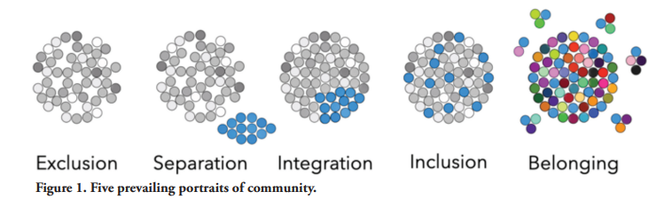
Erik Carter
Five portraits of community
Today there are fewer groups which intentionally exclude disabilities
– Exclusion is often the natural outcome of unintentionality.

Slide 36
4) Inclusion - Ministry with
Inclusion means ensuring individuals with disabilities are encouraged and supported to participate in the same breadth of church experiences as anyone else.
Grounded in core theological beliefs.
More naturally done in smaller congregations- seen as "taking care of __, to be a part of the community.

Slide 37
5) Belonging – Ministry With and By
Lives are shared & mutual friendships form.
“Like anyone else, individuals with disabilities have God-given gifts and compelling friendships that are needed by others within the congregation.”
“A divided body is diminished, for every part needs every other part.” (Carter p6)

Slide 38
Erik Carter
Five portraits of community observed in society and reflected in the current landscape of disability and ministry within the contemporary church.
Ministry apart
Ministry to
Ministry among
Ministry with
Ministry with & by

