Slide 1
Disability Access: Mission with a New Generation
For through him we both have access to the Father by one Spirit.
Ephesians 2:18

Slide 2
Kathy Ayres Coordinator Access Leadership Network

Slide 3



Slide 4
Get Connected
For more information, contact Kathy Ayres (kayres@nextgenanglican.com)
nextgenanglican.com
For through him we both have access to the Father by one Spirit. Ephesians 2:18

Slide 5
Awareness
Calling
Action

Slide 6
Awareness
of what may be a
new way of imagining community and ministry related to those living with disability.

Slide 7
Belonging
“As individuals with and without disabilities develop mutual relationships and see one another as indispensable members, communities soon become places of belonging.”
Erik W. Carter, “The Changing Landscape of Disability and Ministry in the Church,” Currents in Theology and Mission 49:3 (July 2022).

Slide 8
Some statistics related to the prevalence of disabilities:
Canada - The 2017 Canadian Survey on Disability.
22% of Canadians had at least one disability.
This represents 6.2 million people.
Percentage of Canadians with at least one disability:
38% of seniors age 65 and over
Mexico – (statistics are difficult to find)
According to the INEGI 2020 Census, in Mexico there are an estimated
2.61 million people between 0 and 17 years of age with disabilities.
The Global South and the Eastern Provinces – these are beyond the scope of ACNA where I serve, but we are one Mission working for God’s kingdom and his glory.

Slide 9
USA - In 2021, the CDC reported
61 million adults in the USA live with the experience of disability.
1 of 4 adults in the USA had some type of disability
2 in 5 adults age 65 years and older had a disability
Mental Health
Symptoms of Anxiety Disorder – CDC (survey from July 27-Aug 8, 2022)
National Estimate –
28.3% of adults demonstrate symptoms of Anxiety Disorder
When analyzed by Age groups
-the highest percentage was with: 18-29 years old - 39.7%
For Comparison, in 2019 CDC report
8.1% adults age 18 and over demonstrated symptoms of anxiety disorder
Center for Collegiate Mental Health report for 2020-21 academic year:
of 55,156 clients
Anxiety was the top concern identified by clinicians (25.7% of students who came in for an appointment with a campus clinician)

Slide 10
The point is:
people living with
disabilities are in every country…
in every community…

Slide 11
…present in a community - but are often NOT present in our churches.
Church statistics in USA related to disability:
84% of people with disabilities say their
faith is important to them.
Only 45% of people with severe disabilities
attend a place of worship at least monthly.
32% of parents surveyed
changed their place of worship because
their child was not included or welcomed.

Slide 12
We must attune ourselves
to their stories,
learn, grow, and serve together,
to become the complete Body, God calls us toward.
Now you are the body of Christ and individually members of it.
1 Corinthians 12:27

Slide 13
In the last 20 years, there is more emphasis on full inclusion of individuals with disabilities.
Erik Carter describes
five portraits of community observed in society and reflected in the current landscape of disability and ministry within the contemporary church.

Slide 14
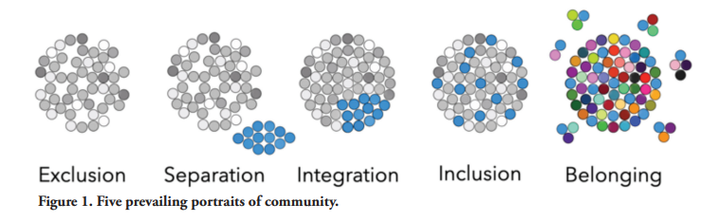
Erik Carter
Five portraits of community
Today there are fewer groups which intentionally exclude disabilities
– Exclusion is often the natural outcome of unintentionality.

Slide 15
4) Inclusion - Ministry with
Inclusion means ensuring individuals with disabilities are encouraged and supported to participate in the same breadth of church experiences as anyone else.
Grounded in core theological beliefs.
More naturally done in smaller congregations- seen as "taking care of __, to be a part of the community.

Slide 16
5) Belonging – Ministry With and By
Lives are shared & mutual friendships form.
“Like anyone else, individuals with disabilities have God-given gifts and compelling friendships that are needed by others within the congregation.”
“A divided body is diminished, for every part needs every other part.” (Carter p6)

Slide 17
Erik Carter
Five portraits of community observed in society and reflected in the current landscape of disability and ministry within the contemporary church.
Ministry apart
Ministry to
Ministry among
Ministry with
Ministry with & by

Slide 18
How do we raise up a new generation of leaders within the ACNA who recognize our mission includes those affected by disability as equal agents of the Gospel?
We must be intentional.

Slide 19
Awareness
Calling
Action

Slide 20
Awareness
Calling
Action

Slide 21
What can my church do?
Practical ways to help in any setting:
Ask – Have online registration for events & activities. Include a line to ask: “Are there any supports or accommodations you need to fully participate?”
Engage – Acknowledge, greet, and give eye contact to people with disabilities. Wrap them into conversations with others.
Admit when you’re not sure what to do – When you see someone struggling, admit you may be unsure how to best help, but let them know you are glad they are here and if we put our heads together we can figure out a way forward to make things better.

Slide 22
Four Teams of Access Leadership Network –
Advocacy Team
Supports parishes in their efforts to bring about genuine belonging in the life of the church for all affected by disability.
This team further seeks to walk alongside people with disabilities to empower them to become their own best advocates.
Resource Team
Connects people and
shares resources to support the church’s ministry with and by people with disabilities.

Slide 23
Training Team
Provides training for churches to build community, foster belonging and make accommodations for individuals with and without disabilities.
Research Team
Researches biblically based and Spirit-led evidence-based perspectives on disability ministry and what it means to be a valued member of the Body of Christ.
Helps guide and inform the other teams of Access Leadership Network and ministry in local churches.
Prayer support
Would like to have a dedicated team praying daily for our work.

Slide 24
Four Teams of Access Leadership Network –
Advocacy Team
Supports parishes in their efforts to bring about genuine belonging in the life of the church for all affected by disability.
This team further seeks to walk alongside people with disabilities to empower them to become their own best advocates.
Resource Team
Connects people and
shares resources to support the church’s ministry with and by people with disabilities.
Training Team
Provides training for churches to build community, foster belonging and make accommodations for individuals with and without disabilities.
Research Team
Researches biblically based and Spirit-led evidence-based perspectives on disability ministry and what it means to be a valued member of the Body of Christ.
Helps guide and inform the other teams of Access Leadership Network and ministry in local churches.
Prayer support
Would like to have a dedicated team praying daily for our work.

Slide 25
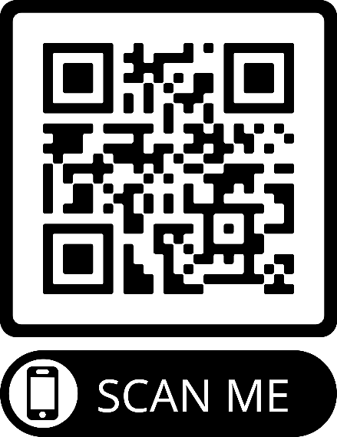
Join the Access Leadership Network (AcLN) –
Sign up for the monthly Newsletter
on our webpage
https://www.nextgenanglican.com/ngli-access
Join the work of a Team – email KAyres@nextGENanglican.com

Slide 26
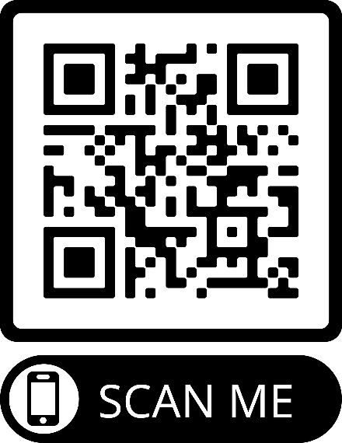
Attend and Invite others to attend
Imago Dei – Welcoming Every Voice.
A collaborative event with Women’s Leadership Initiative and AcLN to listen to voices in the church that are sometimes left out and overlooked.
Men and women are welcome to attend this event.
Join us Thursday at 8:30 PM (ET).
Register to receive a zoom invitation.
Link to register: https://us06web.zoom.us/meeting/register/tZ0kde-sqDgiGNO5MRChKDM8LS62KfrsUzkg

Slide 27
Set up a Meeting with someone at your church
Build a Team to journey with you. –

Slide 28
Get Connected
For more information, contact Jessica Jones (jjones@nextgenanglican.com)
nextgenanglican.com

Slide 29
Get Connected
For more information, contact Kathy Ayres (kayres@nextgenanglican.com)
nextgenanglican.com
For through him we both have access to the Father by one Spirit. Ephesians 2:18

Slide 30
Get Connected
For more information, contact Kathy Ayres (kayres@nextgenanglican.com)
nextgenanglican.com

