Slide 1
Dr. Elena M. Rhodes, PhD
Biological Scientist III
University of Florida
The Reverend Susan T. Rhodes
Assisting Clergy
Servants of Christ Anglican Church

Slide 2
Removing Barriers
Creating Community
Integrating people affected by “invisible” disabilities
Into the life of the Church

Slide 3
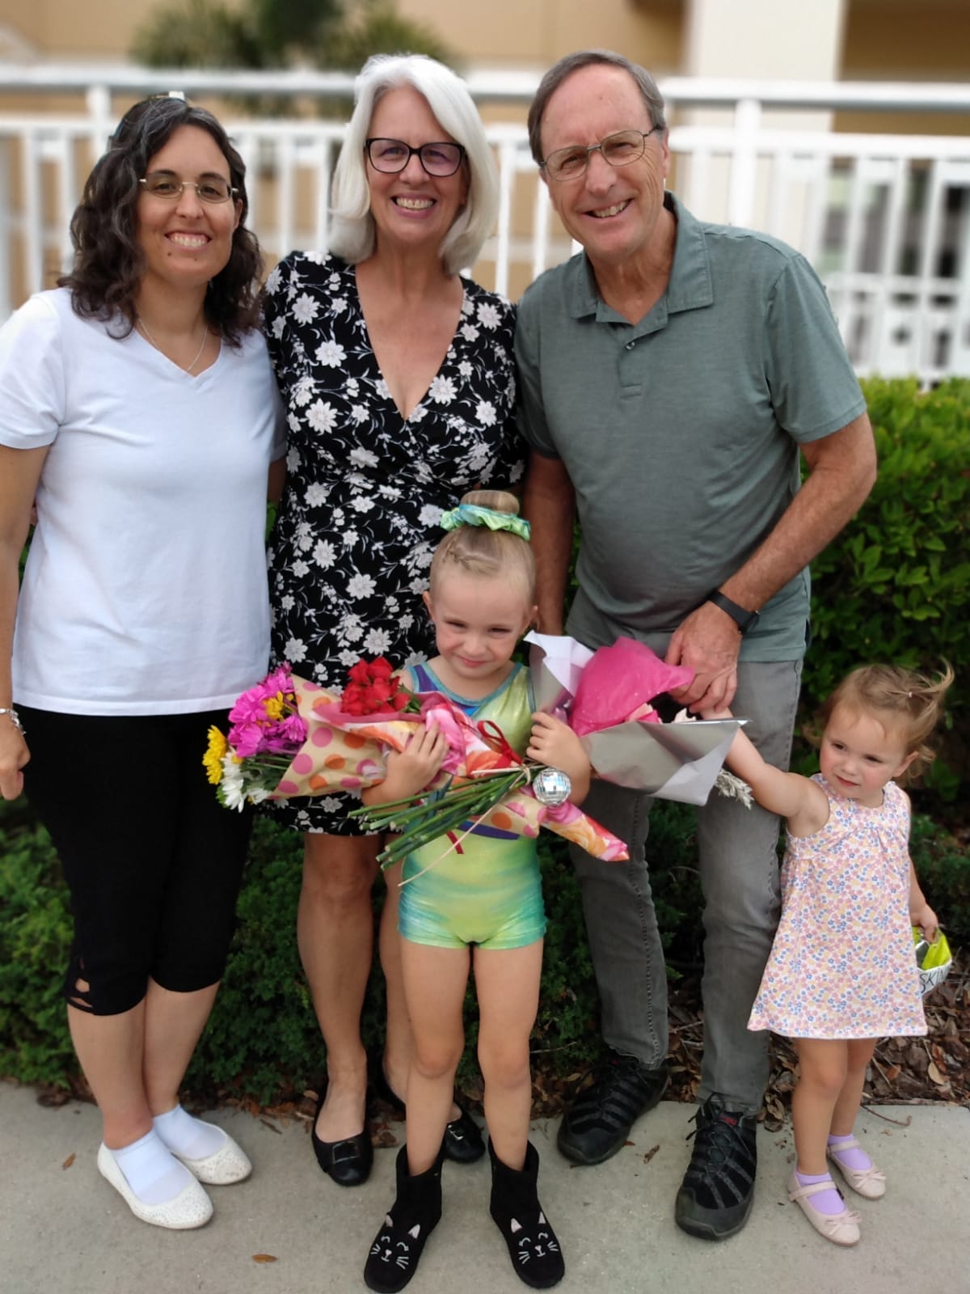
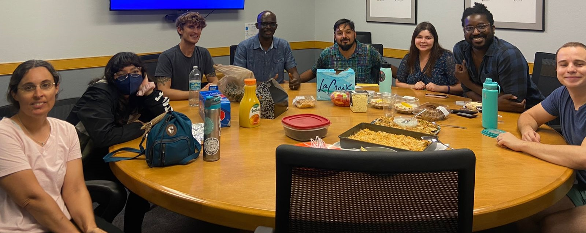
Family
Work

Slide 4

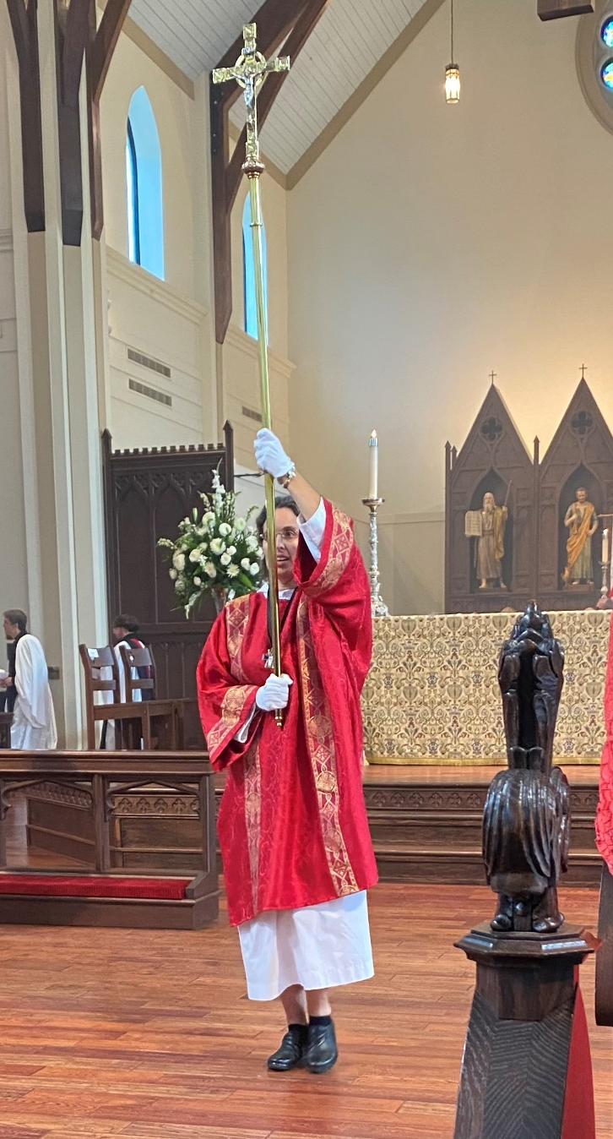
Serve
Pray
Listen,
Love,
and Pray*
*Christian Healing Ministries

Slide 5



Slide 6
Mission:
Encourage proactive and intentional belonging, and participation of anyone affected by disability.
Come alongside churches, ministry workers, and parishioners, to remove barriers and to create community among all God’s image bearers.

Slide 7
Vision:
Provide advocacy for persons affected by disability who require some accommodation to participate fully.
Provide training for churches regarding building community to promote belonging, participation, growth, and service.
Provide resources for best practices in re-envisioning communities where all are recognized as fearfully and wonderfully made, specifically in the areas of liturgical life together.

Slide 8
Leadership Team
Triad of Leadership: one chair and two co-chairs.
Steering Committee
Leads and guides Access Leadership Network, making administrative decisions through seeking the Lord’s guidance and reaching mutual consensus.

Slide 9
Advocacy
Training
Resources
Research guides and informs Advocacy, Resources and Training

Slide 10
Join the Access Leadership Network (AcLN) –
  sign up for the monthly Newsletter list on our webpage
  https://www.nextgenanglican.com/ngli-access
  join the work of a Team – email KAyres@nextGENanglican.com

Slide 11
Attend and Invite others to attend
  Imago Dei – Welcoming Every Voice.
  a collaborative event with Women’s Leadership Initiative and AcLN to listen to voices in the church that are sometimes left out and overlooked.
  Men and women are welcome to attend this event.
  Join us Thursday at 8:30 PM (ET).
  Register to receive a zoom invitation.
Link to register: https://us06web.zoom.us/meeting/register/tZ0kde-sqDgiGNO5MRChKDM8LS62KfrsUzkg

Slide 12
Get Connected
For more information, contact Jessica Jones (jjones@nextgenanglican.com)
nextgenanglican.com

Slide 13
Get Connected
For more information, contact Kathy Ayres (kayres@nextgenanglican.com)
nextgenanglican.com

